Slide 1
Database Design
A database is a collection of data that represents some aspects of real world called “miniworld” or ”enterprise”
What data to store?
Database design starts from understanding user requirements
Understanding…hmm?
Imagine you are designing databases for many customers, with different requirements for sure!
Notes:
To understand, we need to communicate. The problem is how. We need to learn how to talk and how to listen. We human have a variety of ways of communications, such as writing, talking, video, gestures. Here we want an approach that allows us to collect information as much as possible, as flexible as possible, and also as accurately as possible. But unfortunately flexibility and accuracy is often a dilemma.

Slide 2

Communication is hard, very hard
Can you describe this picture?
Can your audience understand what you are talking about?
Imagine your job is to describe pictures (many!!), or to listen and understand the descriptions
What would you do to make your life easier?
This is a million $$$ question.
Notes:
To understand, we need to communicate. The problem is how. We need to learn how to talk and how to listen. We human have a variety of ways of communications, such as writing, talking, video, gestures. Here we want an approach that allows us to collect information as much as possible, as flexible as possible, and also as accurately as possible. But unfortunately flexibility and accuracy is often a dilemma.

Slide 3
How about doing this?
There are 3 persons
Person 1 is a boy
Person 2 is a lady
Person 3 is a man
There is 1 dog
Dog 1 is black
Person 1 and Person 2 are holding hands
Person 2 and Person 3 are holding hands
Person 1 holds the leash of dog 1
For each picture, always follow two steps to describe:
What objects the pictures have?
What interactions these objects have to each other?
Notes:
To understand, we need to communicate. The problem is how. We need to learn how to talk and how to listen. We human have a variety of ways of communications, such as writing, talking, video, gestures. Here we want an approach that allows us to collect information as much as possible, as flexible as possible, and also as accurately as possible. But unfortunately flexibility and accuracy is often a dilemma.

Slide 4
Entity-Relationship (ER) model
ER is a high-level conceptual data model
What data to store?
Database design starts from understanding user requirements
Whatever we do, we want two questions answered:
What entities does this mini-world have?
What relationships exist among these entities?
Notes:
To understand, we need to communicate. The problem is how. We need to learn how to talk and how to listen. We human have a variety of ways of communications, such as writing, talking, video, gestures. Here we want an approach that allows us to collect information as much as possible, as flexible as possible, and also as accurately as possible. But unfortunately flexibility and accuracy is often a dilemma.

Slide 5
Basic terms and notations
An entity is a uniquely identifiable object that exists on its own (e.g., an employee, a department)
Entities have attributes
An attribute is a key attribute if its values are distinct for each individual entity
There may have multiple key attribues
Similar entities (having same attributes) form an entity set
name
name
ssn
dob
did
address
Employees
Departments
Notation
an entity set : a rectangle
an attribute: a circle and a line connected to a rectangle
a key attribute: underlined
Text
there are a number of Entities E, each of which has attribute A1, A2, …, and An, where Ai is unique

Slide 6
Relationship: Association among two or more entities.
Example: Attishoo works in the Pharmacy department.
Relationship Set: Collection of similar relationships.
name
name
since
did
address
ssn
dob
Employees
works-in
Departments
Notation
a relationship set: a diamond
Every participating entity is connected to it by a dotted edge
Every attribute is also connected to it by an edge
an attribute: a circle and a line connected to a rectangle
Text
An Ex may “have to do with” an Ey, where the relationship has attributes A1, A2, …, and An
An Ex and an Ey may participate in a relationship called Rz, which has attributes A1, A2, …, and An

Slide 7
name
name
since
did
address
ssn
dob
Employees
works-in
Departments
e1
e2
e3
e4
e5
e1, d1, 01/01/1998
e3, d3, 01/05/1985
d1
d2
d3
Notes:
Entities + Relationships = World. A world having only entities is a dead world. The relationships among these entities bring the world alive.
Examples: university
faculty
students
buildings
courses
vehicles
research projects
...
Now relationships among these entities

Slide 8
two entity sets may have different relationships
name
name
since
did
address
ssn
dob
Employees
works-in
Departments
manages
since

Slide 9
Entities in a same set can participate in some relationship
name
name
since
did
address
ssn
dob
Employees
works-in
Departments
super-visor
subor-dinate
manages
Since
Reports_To
since

Slide 10
more than two entity sets may participate
in a same relationship set
name
title
terms
cid
ssn
dob
instructors
teach/enroll
course
i1
i2
c1
c2
c3
i1, s1, c1
i1, s2, c1
i2, s3, c1
Instructor i teaches student s enrolled in course c
s1
s2
s3
students
ssn
name
dob

Slide 11
How about this ER diagram? How is it different from the previous one? It may not tell who teach which students. For example, who is teaching s3?
name
title
terms
cid
ssn
dob
instructors
teach
course
c1
c2
c3
i1
i2
i1, c1
i2, c1
Enroll]
s1, c1
s2, c1
s3, c1
Instructor i teaches student s enrolled in course c
i1, s1, c1
i1, s2, c1
i2, s3, c1
s1
s2
s3
students
ssn
name
dob

Slide 12
A relationship may be participated by any number of entity sets
name
title
terms
cid
ssn
dob
teach-
enroll-
use
instructors
course
books
students
bid
title
ssn
name
dob

Slide 13
So far, only two notations E and R, but they are very powerful in describing a “world”. When designing a database, think about these two questions and answer in corresponding grammars
What entities it has
There are a number of E_1, each of which has attributes A_1, A_2, ..., and A_n, where A_i is unique, A_j is unique, and ..., so on; ……
What relationships exist among these entities
E_x “has to do with” E_y, where the relationship has attributes A_1, A_2, ..., and A_n; ……
Example: A database for university
E: faculty, students, courses, buildings, vehicles, research projects, departments, parking lots ...
R: A faculty teaches some students in buildings...

Slide 14
The two questions are fundamental – most descriptions in user requirements can be translated into
E: There are a number of Entities E, with attributes a1, …, an
R: Entity A has a relationship with Entity B
However, there are usually other information, e.g.,
Every student must take at least one course
A vehicle can be registered under only one driver
A vehicle must be registered under one and only one driver
As such, we want to expand the basic form of ER to express participation constraints
Things start to get complicate!!

Slide 15
Uni-participation (also called key constraint)
Each entity in an entity set can participate in at most one relationship in a relationship set
Notation: u
If there is no such constraint, then it is called multi-participation, denoted as m
m
u
Employees
Manages
Departments
e1
e2
e3
e4
e5
e1, d1
e1, d3
e2, d2
e1, d1
e2, d1
d1
d2
d3
which one allowed?
A department can participate in relationship “manages” at most one time
➔Every department can have at most one manager (but does not have to)

Slide 16
Total participation
Every entity in an entity set must participate in a relation set
Notation: solid line
If there is no such constraint, then it is called partial-participation, denoted as dotted line
m
m
Employees
Manages
Departments
e1
e2
e3
e4
e5
e1, d1
e1, d3
e1, d1
e2, d1
e2, d3
e3, d3
d1
d2
d3
which one allowed?
Every department must participate in relationship “manages”
→ Every department must have at least one manager

Slide 17
Uni-participation and total participation
Every entity in an entity set must participate in a relation set and participate only once
Notation: u and solid line
m
u
Employees
Manages
Departments
e1
e2
e3
e4
e5
e1, d1
e1, d3
e1, d1
e2, d1
e2, d3
e3, d3
d1
d2
d3
which one allowed?
Every department must participate in relationship “manages” and only once
→Every department must have one and only one manager

Slide 18
Quick Review: Participation Constraint
Question 3: Is there any participation constraint on relationships?
Uni-participation: An entity can participate in a relationship at most once
Total-participation: Every entity in an entity set must participate in a relationship
A combination of both: Every entity in an entity set must participate in a relationship but only once

Slide 19
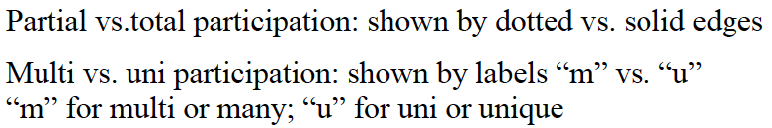
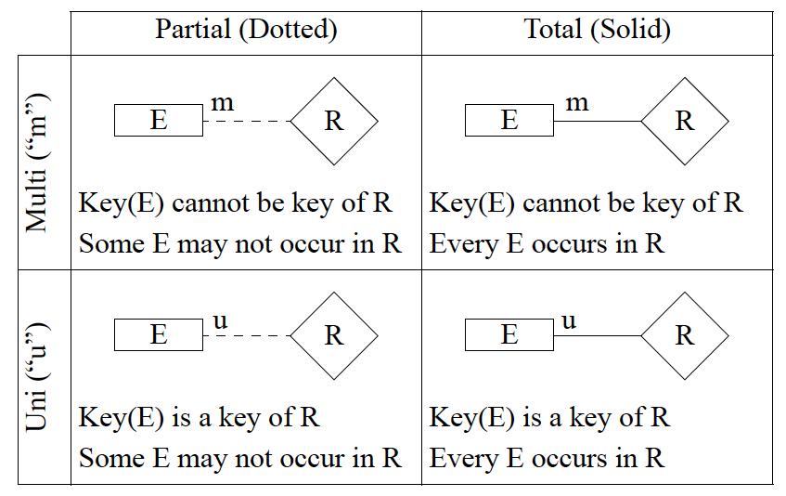
Notations used in this class

Slide 20
No standards on notations: Different notations may be used by different books, companies, or tools
Partial vs. total participation: shown by a thin line vs a thick line
Multi vs uni participation: shown by a line without vs with an arrow
Partial ( thin line)
Total ( thick line)
Multi ( no arrow)
R
E
R
E
Some E may not occur in R
Every E occurs in R
Uni (arrow)
E
R
E
R
An E may occur in R only once
Every E must occur in R and occur only once

